Slide 1

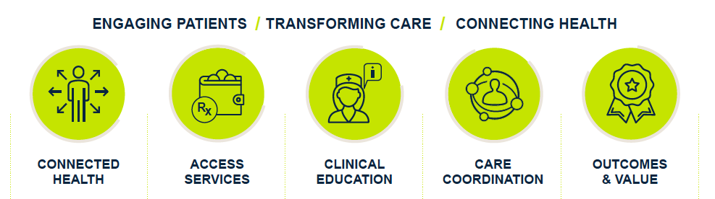
Pre- Asembia Tweet Recommendations
Tweet date: 4.27
Tweet date: 4.28
UBC is at #Asembia next week to talk about why technology backed by personal services is a better approach for improving patient outcomes. Contact us to join at www.UBC.is
So what is the new UBC all about? Find out at www.UBC.is #Asembia
*Image to attach
*Additional hashtags around Asembia may be added dependent on what’s trending

